Slide 1

“WIRELESS SENSOR ADHOCK NETWORK”
WAJID ALI KHAN 24600
SYED NISAR SHERAZI 24592
MUHAMMAD TARIQ KHAN 24569 SYED NADEEM SHERAZI 24591
Supervisor Name: Engr. FAHEEM AWAN
Department of Information Technology,
Hazara University, Mansehra

Slide 2
Outline
Problem Statement
Project Objective
Project phases
System Block Diagram
Conclusion / Recommendations
References
Questions
“WIRELESS SENSOR ADHOCK NETWORK”

Slide 3
Problem Statement
Mostly project on either motion sensor or temperature sensor.
In our project both temperature and motion sensors.
Transmit data through Zigbee which is less power consuming as compared to others.
“WIRELESS SENSOR ADHOCK NETWORK”

Slide 4
Project Objective
To present an idea that can be used in any field like hospitals, industries, colleges, universities, research labs etc.
To send messages or sensors data to any end node wirelessly.
“WIRELESS SENSOR ADHOCK NETWORK”

Slide 5
Project phases phase 1
12v DC power supply is connected to the At mega controller.
Two sensors are connected to the At mega controller.
Temperature sensor which will sense the temperature from the room and send it to the At mega controller.
light intensity sensor will sense light of the room and send it to At mega controller.
At mega controller transfer its data to intermediate node through zigbee.
12 v
controller
zigbee
Temperature
Light Intensity
Thesis Title

Slide 6
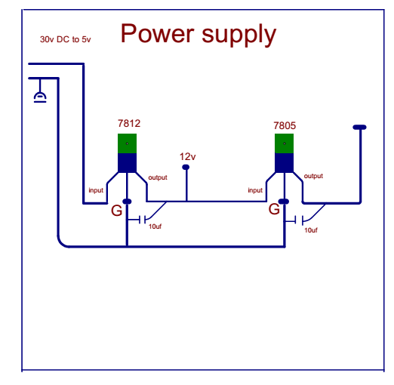
Software work for phase 1
PCB design for 12V DC power supply by the help of CADE SOFT EAGLE SOFTWARE.
2 voltage regulator 7812 and 7805.
7812 which converts 30 DC volt to 12 volt and 7805 which will convert 12 volt into 5 volt
Thesis Title

Slide 7
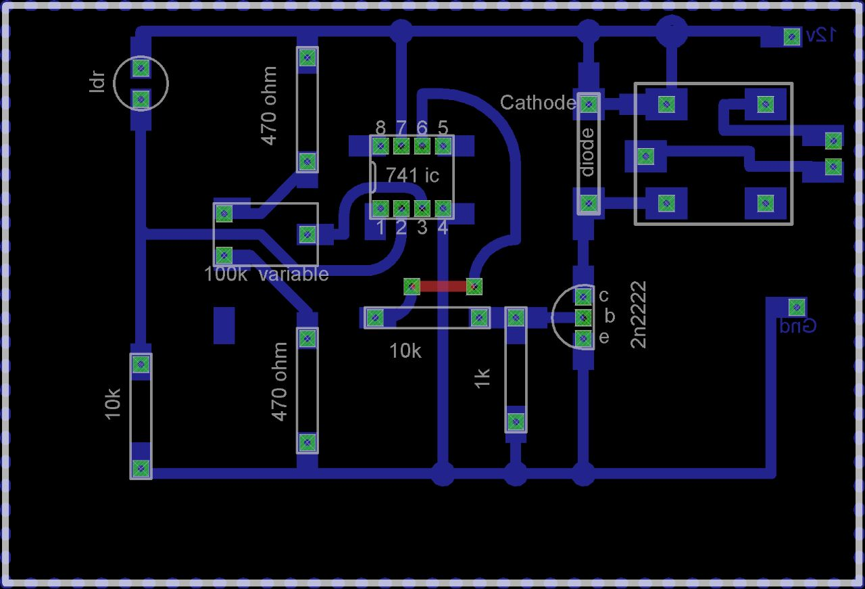
Software work for phase 1
Light Intensity:
Thesis Title

Slide 8
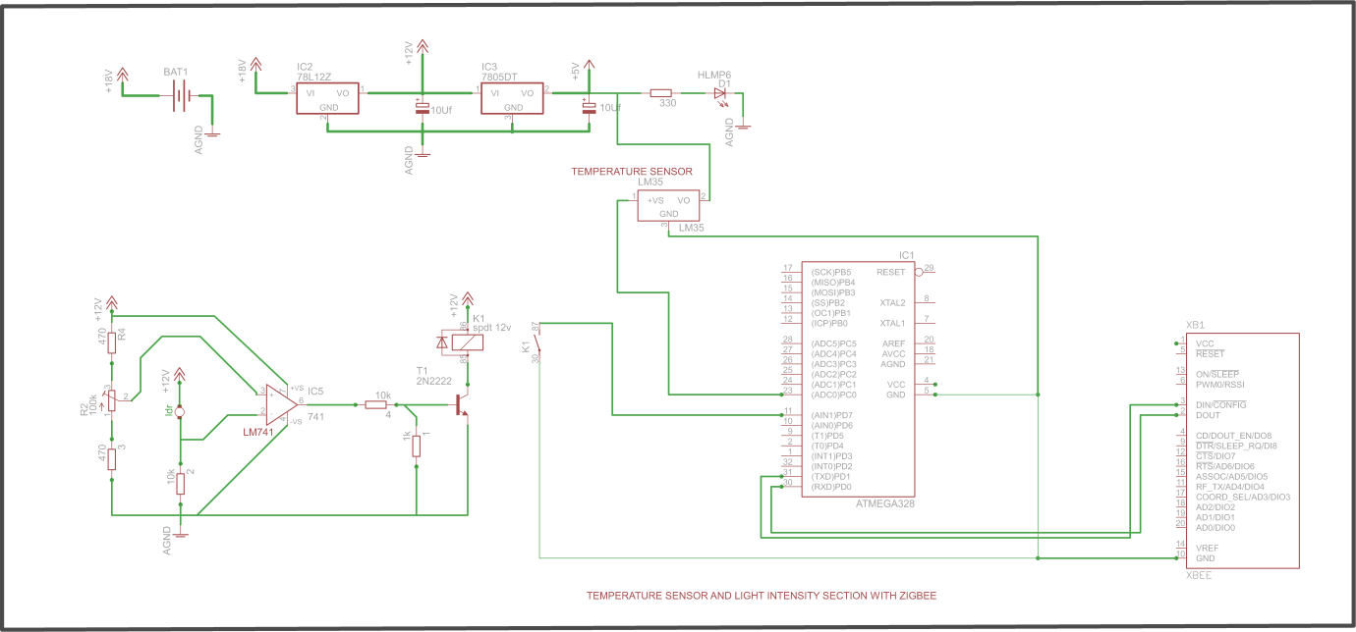
Schematic of phase 1
PCB design for 12V DC power supply, temperature sensor, light intensity sensor, controller by the help of CADE SOFT EAGLE SOFTWARE.
Thesis Title

Slide 9
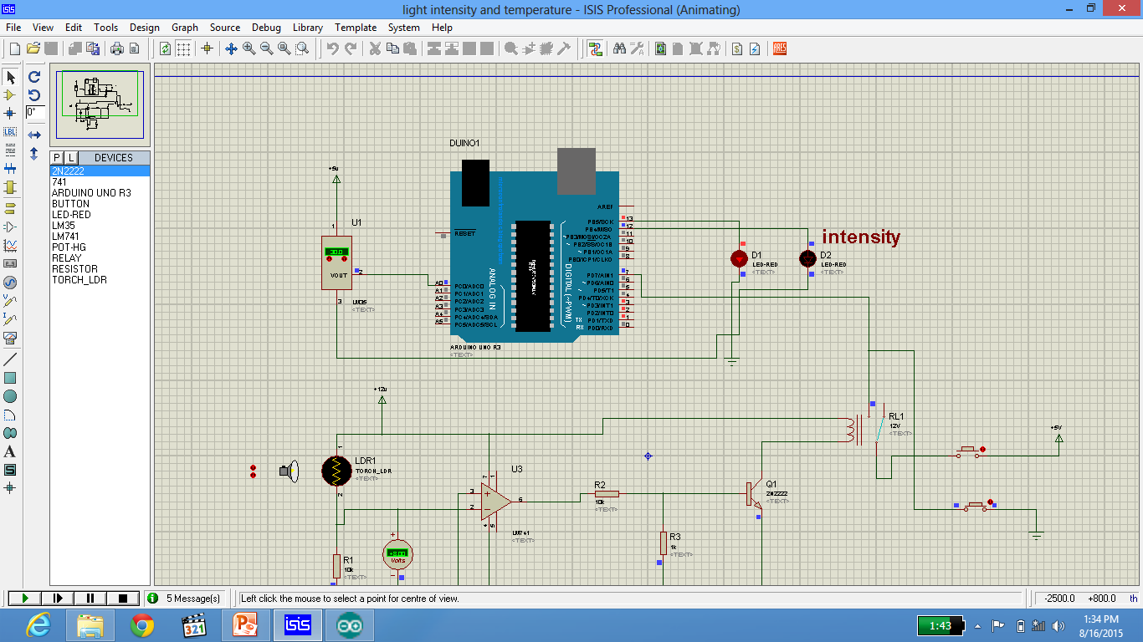
Simulation of phase 1
Thesis Title

Slide 10
Phase 2
Zigbee will receive the data from phase one and give it to the intermediate node (controller).
A 12v DC power supply is connected to controller to give the power to the controller.
We have connected the load 1 and load 2 to intermediate node now when the intermediate node receives the data from zigbee it will transfer it to load 1 and load 2.
motion detector sensor to intermediate node.
controller will send this data to another controller through zigbee .
Intermediate Node
controller
zigbee
12 v
Load 1
Load 2
Motion sensor
Thesis Title

Slide 11
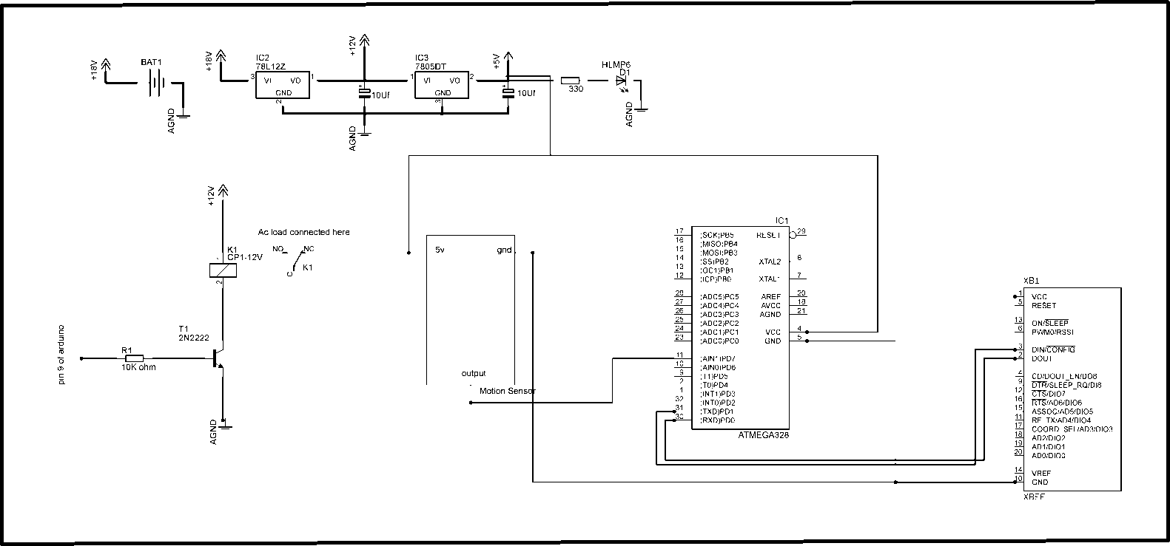
Schematic of phase 2
Complete diagram of phase 2 which is been made by CADSOFT EAGEL SOFTWARE.
Thesis Title

Slide 12
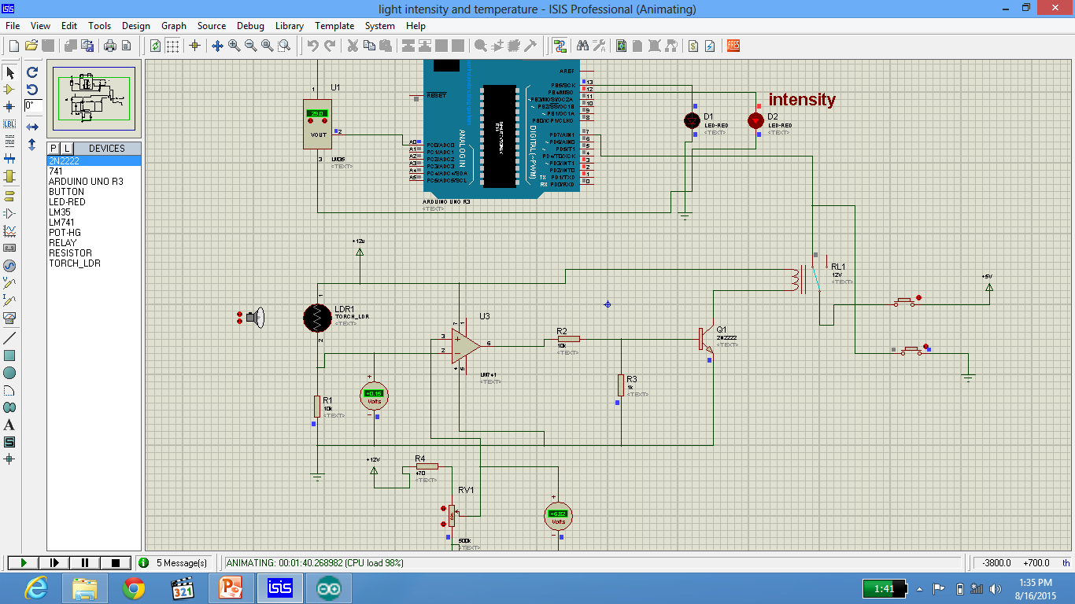
Simulation of phase 2
Thesis Title

Slide 13
Phase 3
In this phase zigbee will receives data from phase 2.
Zigbee will receive the data and send it to computer server.
Computer server will monitor and control.
On computer display we can see the motion, temperature and light intensity.
Computer server
Monitoring and control
zigbee
Thesis Title

Slide 14

Simulation of phase 3
Thesis Title

Slide 15
Phase 4
In this phase we have design the project on hardware.
Thesis Title

Slide 16
System Block Diagram
Sample Block diagram of a system
12 v
controller
zigbee
Temperature
Light Intensity
12 v
Intermediate Node
controller
zigbee
Load 1
Load 2
Motion sensor
Computer server
Monitoring and control
zigbee
“WIRELESS SENSOR ADHOCK NETWORK”

Slide 17
Conclusion
This method provides a nice computing efficiency…
Project Title

Slide 18
Recommendations for future work
Give Recommendations for future work (if any)
Project Title

Slide 19
References
http://www.electronics-tutorials.ws/resistor/res_1.html
http://www.learningaboutelectronics.com/images/SPDT-relay-diagram.png
http://www.electronicshub.org/understanding-7805-ic-voltage-regulator/
http://www.globalspec.com/industrial-directory/7812_voltage_regulator_ic
www.eletrica.ufpr.br/ufpr2/professor/36/TE215/2N2222
http://electronics.howstuffworks.com/question537.html
“WIRELESS SENSOR ADHOCK NETWORK”

Slide 20

Thank You
If you have any Questions
Please Go ahead.
Project Title

